Slide 1
Eye-based wheelchair control and task manager for disabled person
Notes:
Hello everyone, Assalamualaikum

Slide 2
KUET.CV
Rahat-uz-Zaman
Sakib Reza
Hasib Iqbal Pranto
Asifur Rahman
Department of Computer Science and Engineering
Khulna University of Engineering and Technology
Notes:
I am Rahat Zaman of KUET.CV from Khulna University of Engineering and Technology, Bangladesh

Slide 3
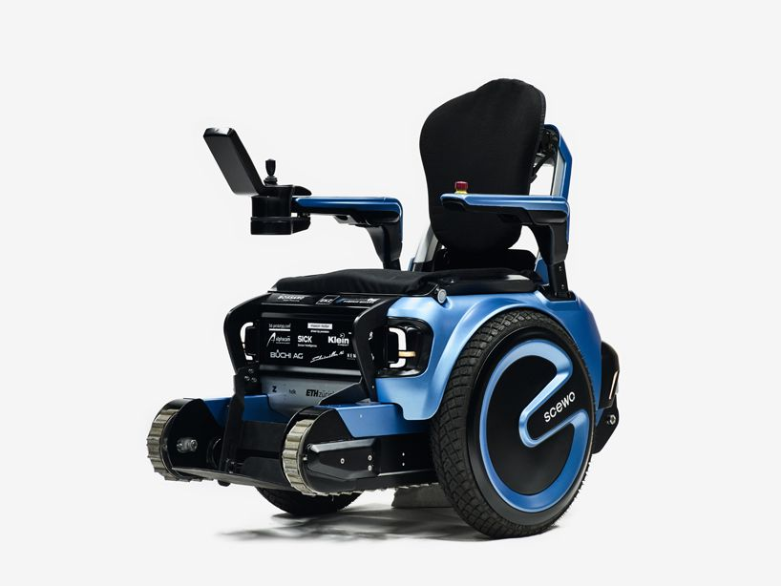
Overview
In our society, there are people who have critical physical disability, some of them have paralysis, cannot move any body part except only eyes and/or head. Our system will make them able to operate wheel chair and task manager using their eyes, voice and/or head gesture.
Notes:
Did you know that just of 1 in 4 of today’s 20 year-olds will become disabled before they retire? And also this fact that estimated population of people with disabilities are 650 million where abour 33% of them are unable to move? [SourceAmerica]
That is why we came up with an innovative Idea that is never been thought before and has a high probability to change the world for disabled person.

Slide 4
Eye-based wheelchair control and task manager for disabled person
Notes:
We have designed a system where those person can do almost all daily works with only their active parts like eye, voice and head. The name of our project is Eye-based wheelchair control and task manager for disabled person.

Slide 5
Aim and Objectives
Overcoming any type of physical disability using eyes, voice and/or head gesture
Operating task manager and wheel chair using eye gaze/eye blink/head gesture/ voice command
Make disabled persons able to do everyday works
Notes:
With our project, we want to overcome the physical disabilities with only eye, head etc. It will also improve the economy of a country by adding labors of disabled persons. So we added as much functionality as possible which can be done only with eye.

Slide 6
Who can use this with which features
Person’s active body part |  |  |  |  | Feature
Hand | Leg | Eye | Head | Speak | Voice | Eye-gaze | Eye-blink | Head-guesture
❌ | ❌ | ✔ | ❌ | ❌ | ❌ | ✔ | ✔ | ❌
❌ | ❌ | ✔ | ❌ | ✔ | ✔ | ✔ | ✔ | ❌
❌ | ❌ | ✔ | ✔ | ❌ | ❌ | ✔ | ✔ | ✔
❌ | ❌ | ✔ | ✔ | ✔ | ✔ | ✔ | ✔ | ✔
❌ | ❌ | ❌ | ❌ | ✔ | ✔ | ❌ | ❌ | ❌
Notes:
This is the chart by which we can see that who are our targets and we can see that almost all severly disabled persons can use our software with ease. For example, a person who have only eye and head as his active part can use all of our features.
So what can we do with the idea implemented software? The answer is EVERYTHING.

Slide 7
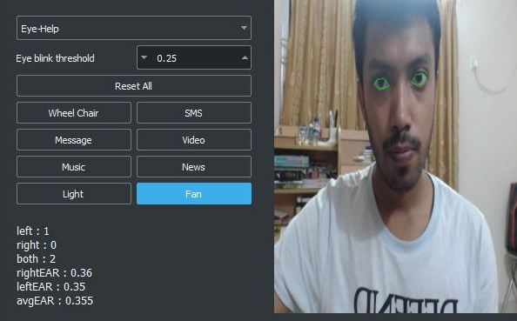
Task manager to control both menu and wheel chair
The person can do the following things with this task manager.
Control wheel chair
SMS
Email
Video
Music
News
Turn on/off light
Turn on/off fan
Place your screenshot here
Control tasks by
Eye
Head
Voice
Notes:
We have a task manager by which, the user can control and do things with their active parts. They can send sms, email. They can select from a list of videos and play and pause with their ease. Same as video they can also listen to audio. They can read eBooks, they can scroll with their eyes. They can also control the rooms light and fan if they want. They can browse the internet and if they are in some sort of trouble, they can just navigate and press an emergency button to send an sms to a supervisor. We can add more functionality in the future if we want.
So, how can we navigate and do this much things with only eye and head? We have optimistically designed the navigation system of our software just for this purpose.
Now, there are 3 methods the user can give input according to the chart we have seen previously. They are, eye-help, head-help and voice-help.

Slide 8
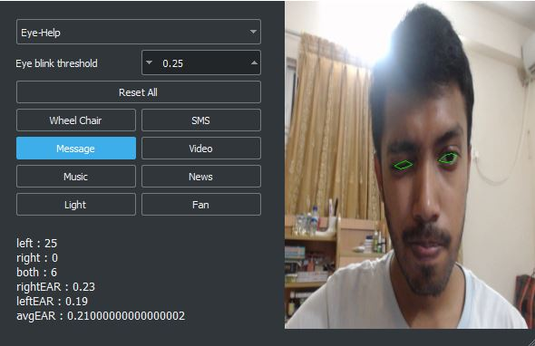
Controlling menu with eye blinks
One can use only blinks to navigate through the whole task manager.
Place your screenshot here
Blink right
Blink left
Blink both
Move selection right
Move selection left
Press selected menu
Notes:
With only the eye blink, you can navigate through the menu and do almost anything. You blink left to go left and blink right to go right. Press the button by blinking both eyes.

Slide 9
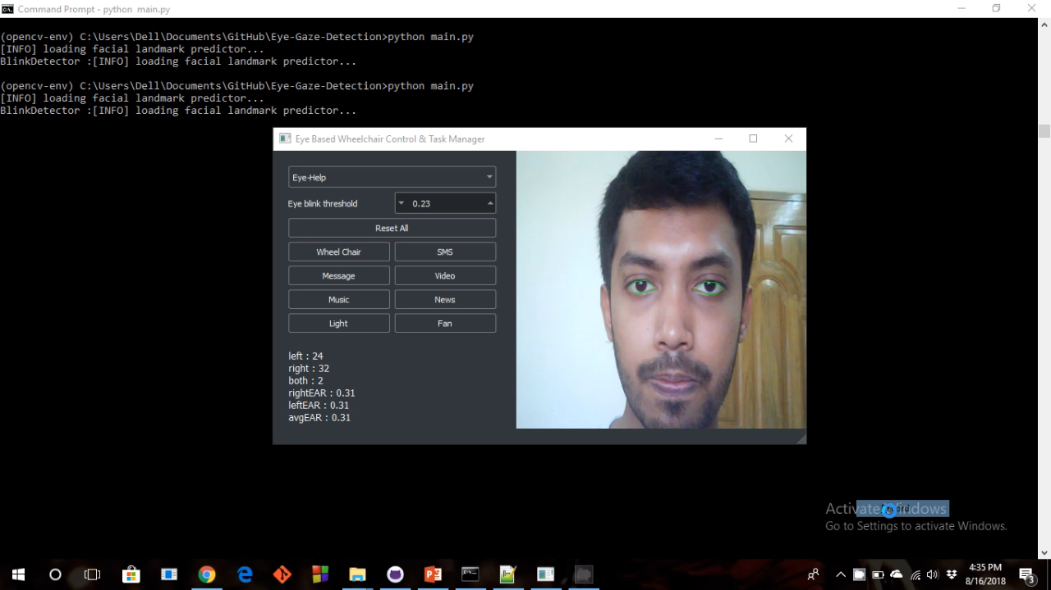

Slide 10
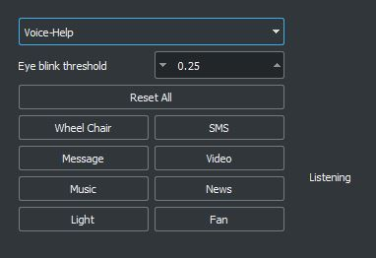
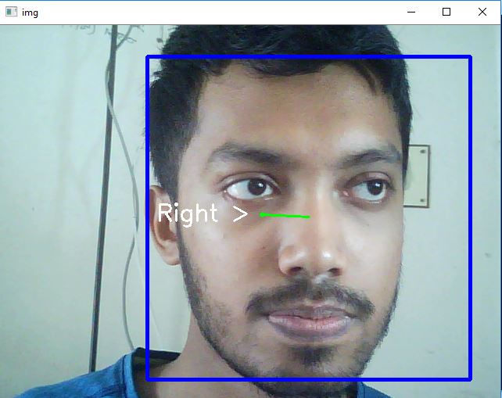
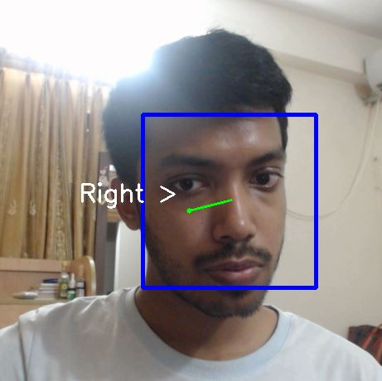
Navigate task manager with head gesture
Go 4 directions with head gesture and select options with eye blinks.
Place your screenshot here
Move right
Move left
Move up
Move selection right
Move selection left
Move selection up
Move down
Move selection down
Notes:
If you switch to head help mode, you can do everything with your head instead. Move your head to both navigate and control both task manager meny and wheelchair respectively.

Slide 11
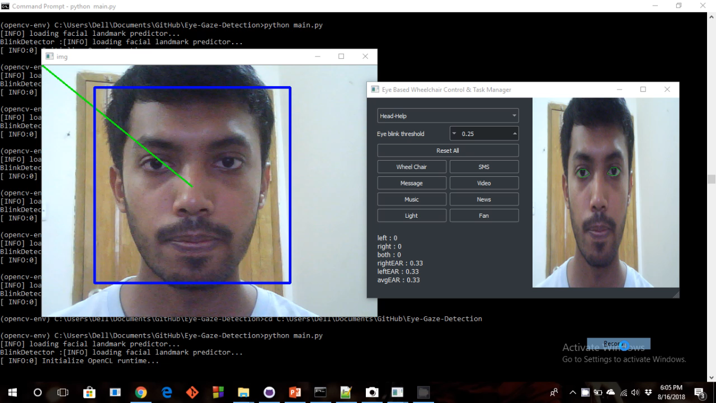

Slide 12
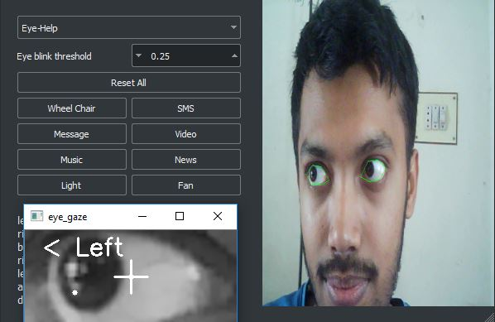
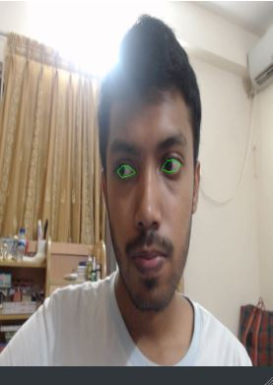
Controlling wheel chair with eye gaze
One can go 3 directions with eye gaze and start/stop with eye blinks.
Place your screenshot here
Look right
Look left
Look front
Move wheel chair right
Move wheel chair left
Move straight
Blink
Start/Stop
Notes:
To control the users wheelchair, go to wheelchair mode and use your eye gaze to go where ever you want and then get out of wheelchair mode. Its like going wherever you loot at.

Slide 13
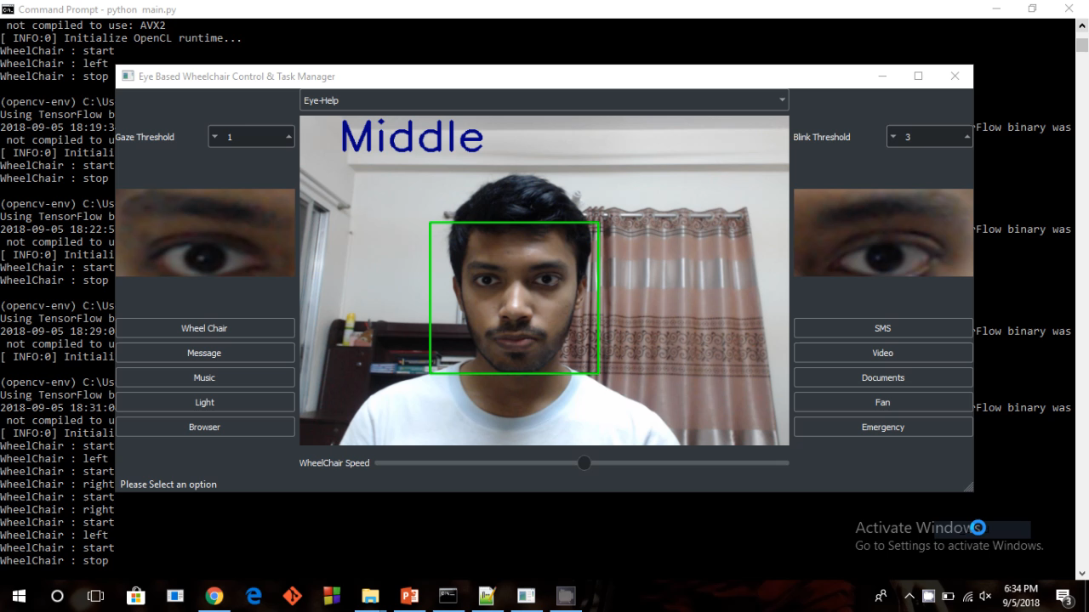

Slide 14
Controlling wheel chair with head gesture
Go 3 directions with head gesture and start/stop with eye blinks.
Place your screenshot here
Move right
Move left
Move up
Move wheel chair right
Move wheel chair left
Move straight
Move down
Stop

Slide 15
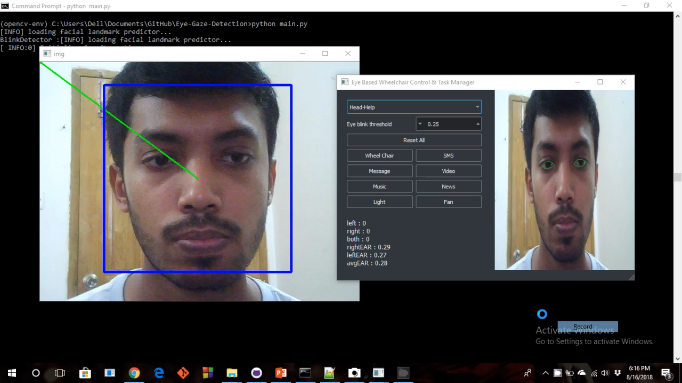

Slide 16
Controlling wheel chair and task manager with voice command
Tell the task manager what to do.
Place your screenshot here
“Right”
“Left”
“Start”
Move wheel chair right
Move wheel chair left
Move straight
“Stop”
Stop
Notes:
We have also a voice help mode for the user where you just speak what you want and the task manager will do it for you.
Despite all of these, the user will not be able to do much of things because, the main problem after solving this previous problem is that, how does the user type?
The answer is eye controlled keyboard…

Slide 17
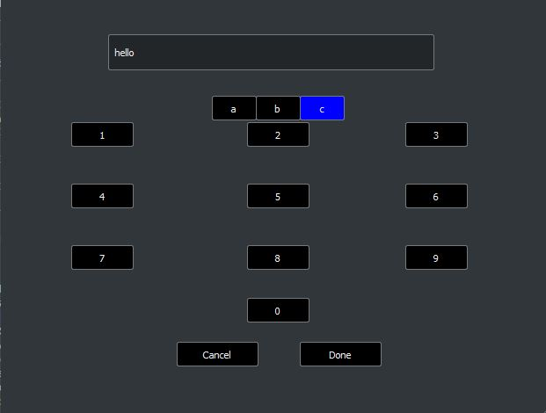
Doing Different tasks with Specially designed eye controlled virtual Keyboard
Can be used with different features.
Place your screenshot here
Blink right/left
Gaze left/right
Blink both
Move main keys left/right
Move floating keys left/right
Select a key
Notes:
A keyboard specially designed to type with your eye. Blink left or right to go through this numpad, and look left and right to move through the floating buttons. Its like a keypad in a featured phone. But its very convenient and fast compared to impossible for the user to type.

Slide 18
Sending Email
User can sent email to take appointment of his/her doctor or in any other communicational purposes.
User can use prewritten Email or can write it with our eye controlled virtual keyboard.
Notes:
The user can send email to any person including taking appointment from the doctor.

Slide 19
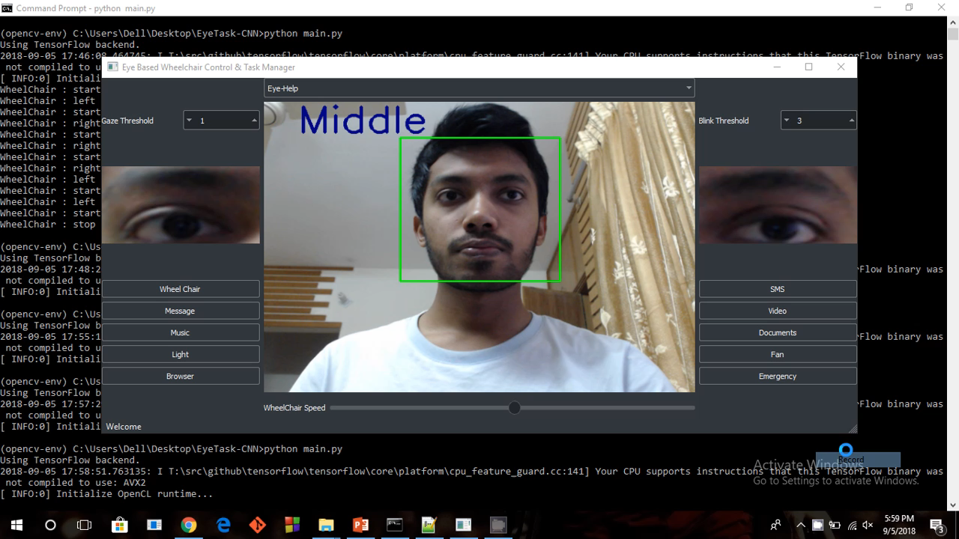

Slide 20
Sending SMS
User can sent SMS to ask for help in emergencies or in any other communicational purposes
User can use prewritten SMS or can write it with our eye controlled virtual keyboard.
Notes:
Sending sms is also similar to sending email. You just need to provide the phone number instead of email address in the software.

Slide 21


Slide 22
Entertainment (Audio/Video)
User can listen/watch any audio or video for his/her entertainment purpose from a collection
User can use our eye controlled virtual keyboard to search his/her desired media file and can play/pause with eye blinks
Blink right
Blink both
Blink left
Select a media file from list
Exit
Play/Pause
Next from the list
Notes:
If the supervisor predefines a folder with a collection of videos to the software, the user can open those videos, play or pause videos, and search through the videos using the virtual eye-controlled keyboard.

Slide 24
Read Documents / Browse website
User can read any document(i.e- E-book) and can scroll it up/down with his/her eyes.
User can use our eye controlled virtual keyboard to search doc and write URL of any website to browse.
Blink right
Blink left
Blink both
Scroll up
Select/exit
Scroll down
Notes:
The user can read open a document from a predefined folder, can read and scroll it with eyes, and can close the book after finishing it. Alse the user can surf the internet with a browser and the power of virtual eye controlled keyboard.

Slide 25
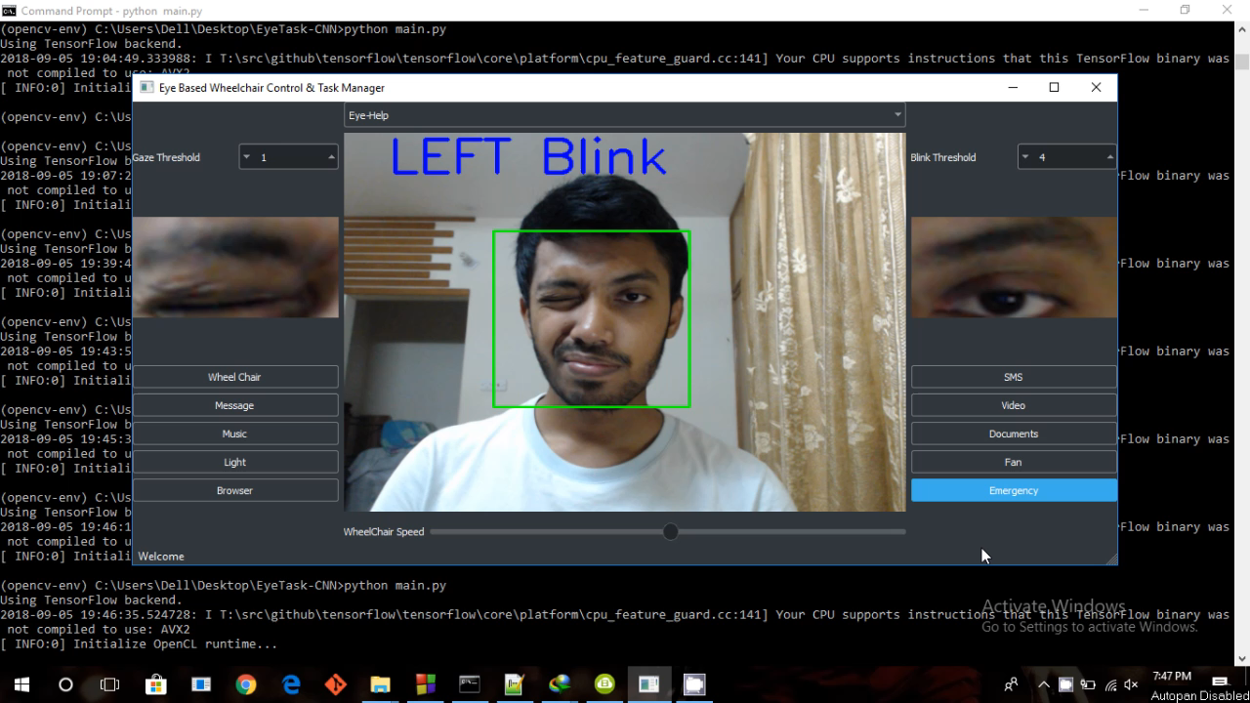

Slide 26
Software Design
Graphical User Interface:
GUI Framework PyQt5
Styling library QdarkStyle.
Computer Vision:
Eye Gaze/blink classifier VGG-8 (Modified)
Training set sample 5000+
Ration of Training and Test Set 80 : 20
Accuracy on our own Test Set 97% (approx.)
Notes:
Now we will be going into the backend of the software. We have used all the latest bleeding edge technology in our project. For gui design, we have to create lots of signal and slots, modifying the library frameworks itself. And for eye control, we have used a lot of modern concepts of computer vision.

Slide 27
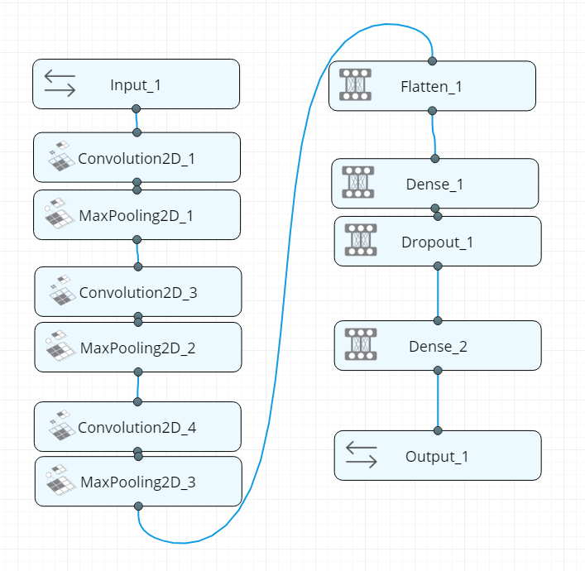
Software Design (Cont.)
Neural Network Architecture:
Modified version of VGG-8
Notes:
We have used deep learning algorithms which is a part of machine learning for our projects, and this is the neural network architecture, which is basically a modified version of VGG-8 net.

Slide 28
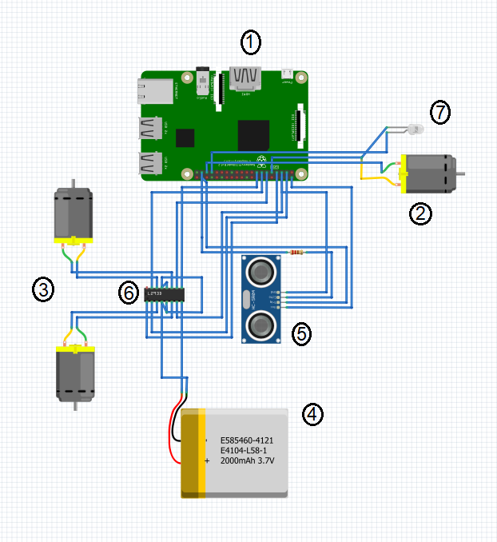
Hardware Design
1. Raspberry PI 3 Model B (1 unit)
2. DC Motor 4V (1 unit)
3. DC Motor 9V (2 unit)
4. Lipo Battery 2200 mAh (1 unit)
5. Ultrasonic Sensor (1 unit)
6. L298N Dual Motor Controller (1 unit)
7. LED (1 unit)
Notes:
This is the hardware design for our project. For taking account the cost, along with wheelchair, we are going to be needing a raspberry pi, 2 dc motors, one rechargeable battery. We have also used a sonar for safety. If something goes wrong and the wheel chair keeps moving by itself, it will automatically stop after finding a blockage ahead.
The extra cost other than wheelchair are, 5$ for raspberry pi, 1$ for sonar, 3$ for dc motor, so in total 9$ for the whole project. Also, for the production, you may change the rpi with a embedded microchip which will cost less than a dollar. So then the price will be only 5$ to change the whole life of a disabled person.

Slide 29
Our Future Plan
Increasing the accuracy of eye gaze, eye blink, head gesture and voice command
Adding more real life features
Making this system more robust, accurate and deployable for general users
Notes:
Our future

Slide 30
Thank You!
Any questions?
Please feel free to ask us
Notes:
Thank you every one for giving me the opportunity to present our idea and to share its implementation difficulty.

